Slide 2
Guidelines for using slides for presentations
Create a custom slide deck:
Save this file with a new name then delete the slides you don’t want to include in a specific presentation
Or copy and paste specific slides from this slide deck into your own PowerPoint file
For each selected slide:
Use the entire slide as is and do not modify it so the Kentucky Cancer Needs Assessment acknowledgment and data sources are listed appropriately

Slide 4
Executive Summary

Slide 5
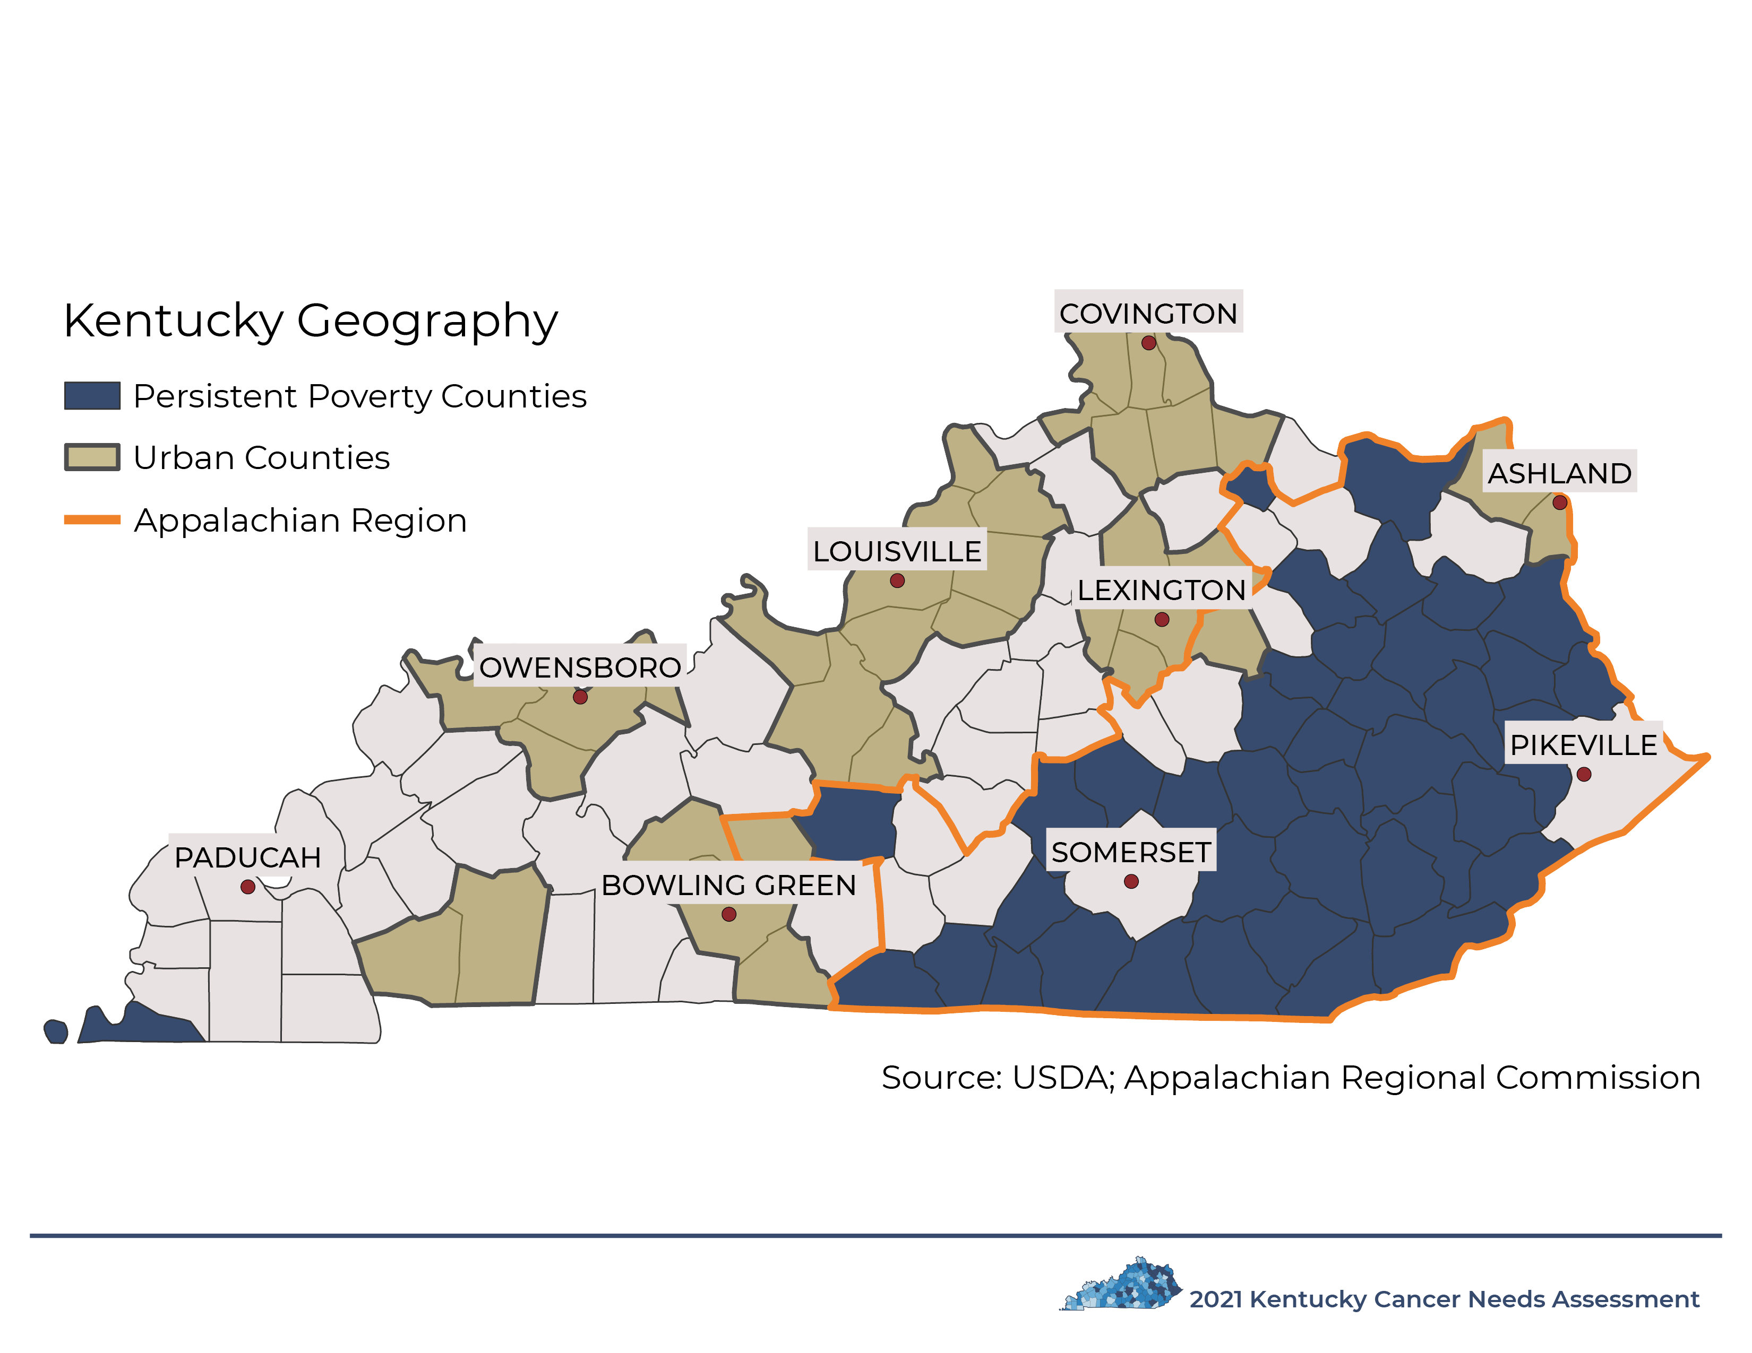

Slide 8
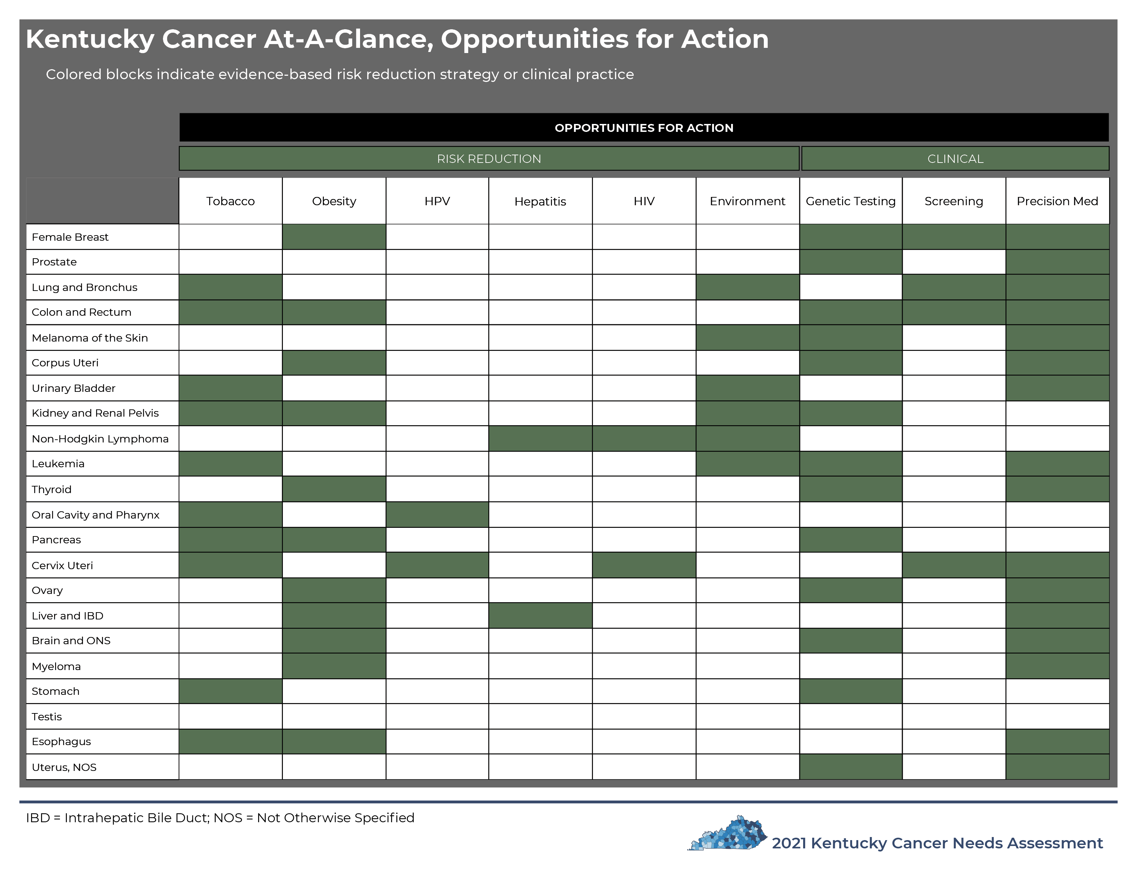

Slide 10
Section 1: Introduction

Slide 14
Section 2: Social Determinants of Health

Slide 17
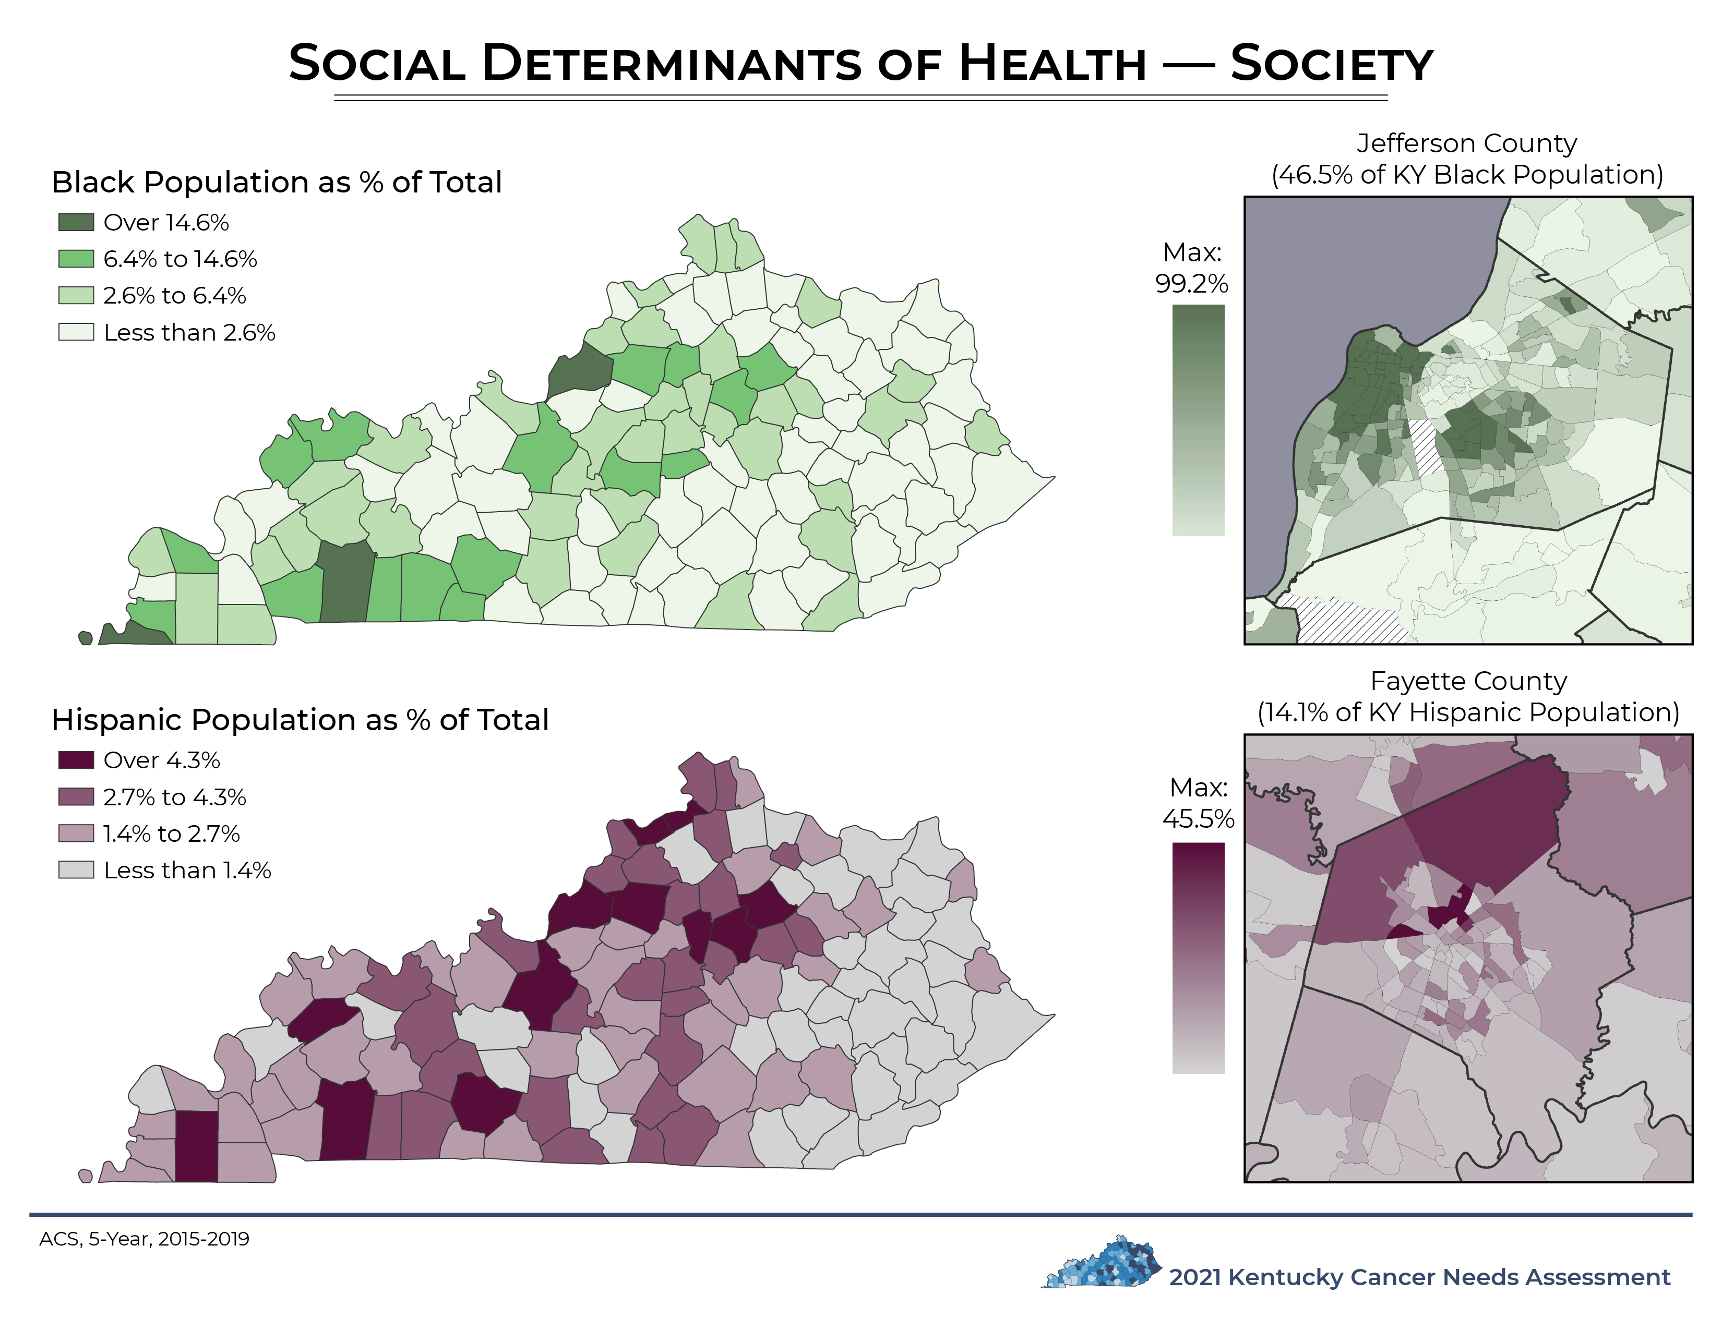

Slide 27
Section 3: Cancer-related Outcomes

Slide 35
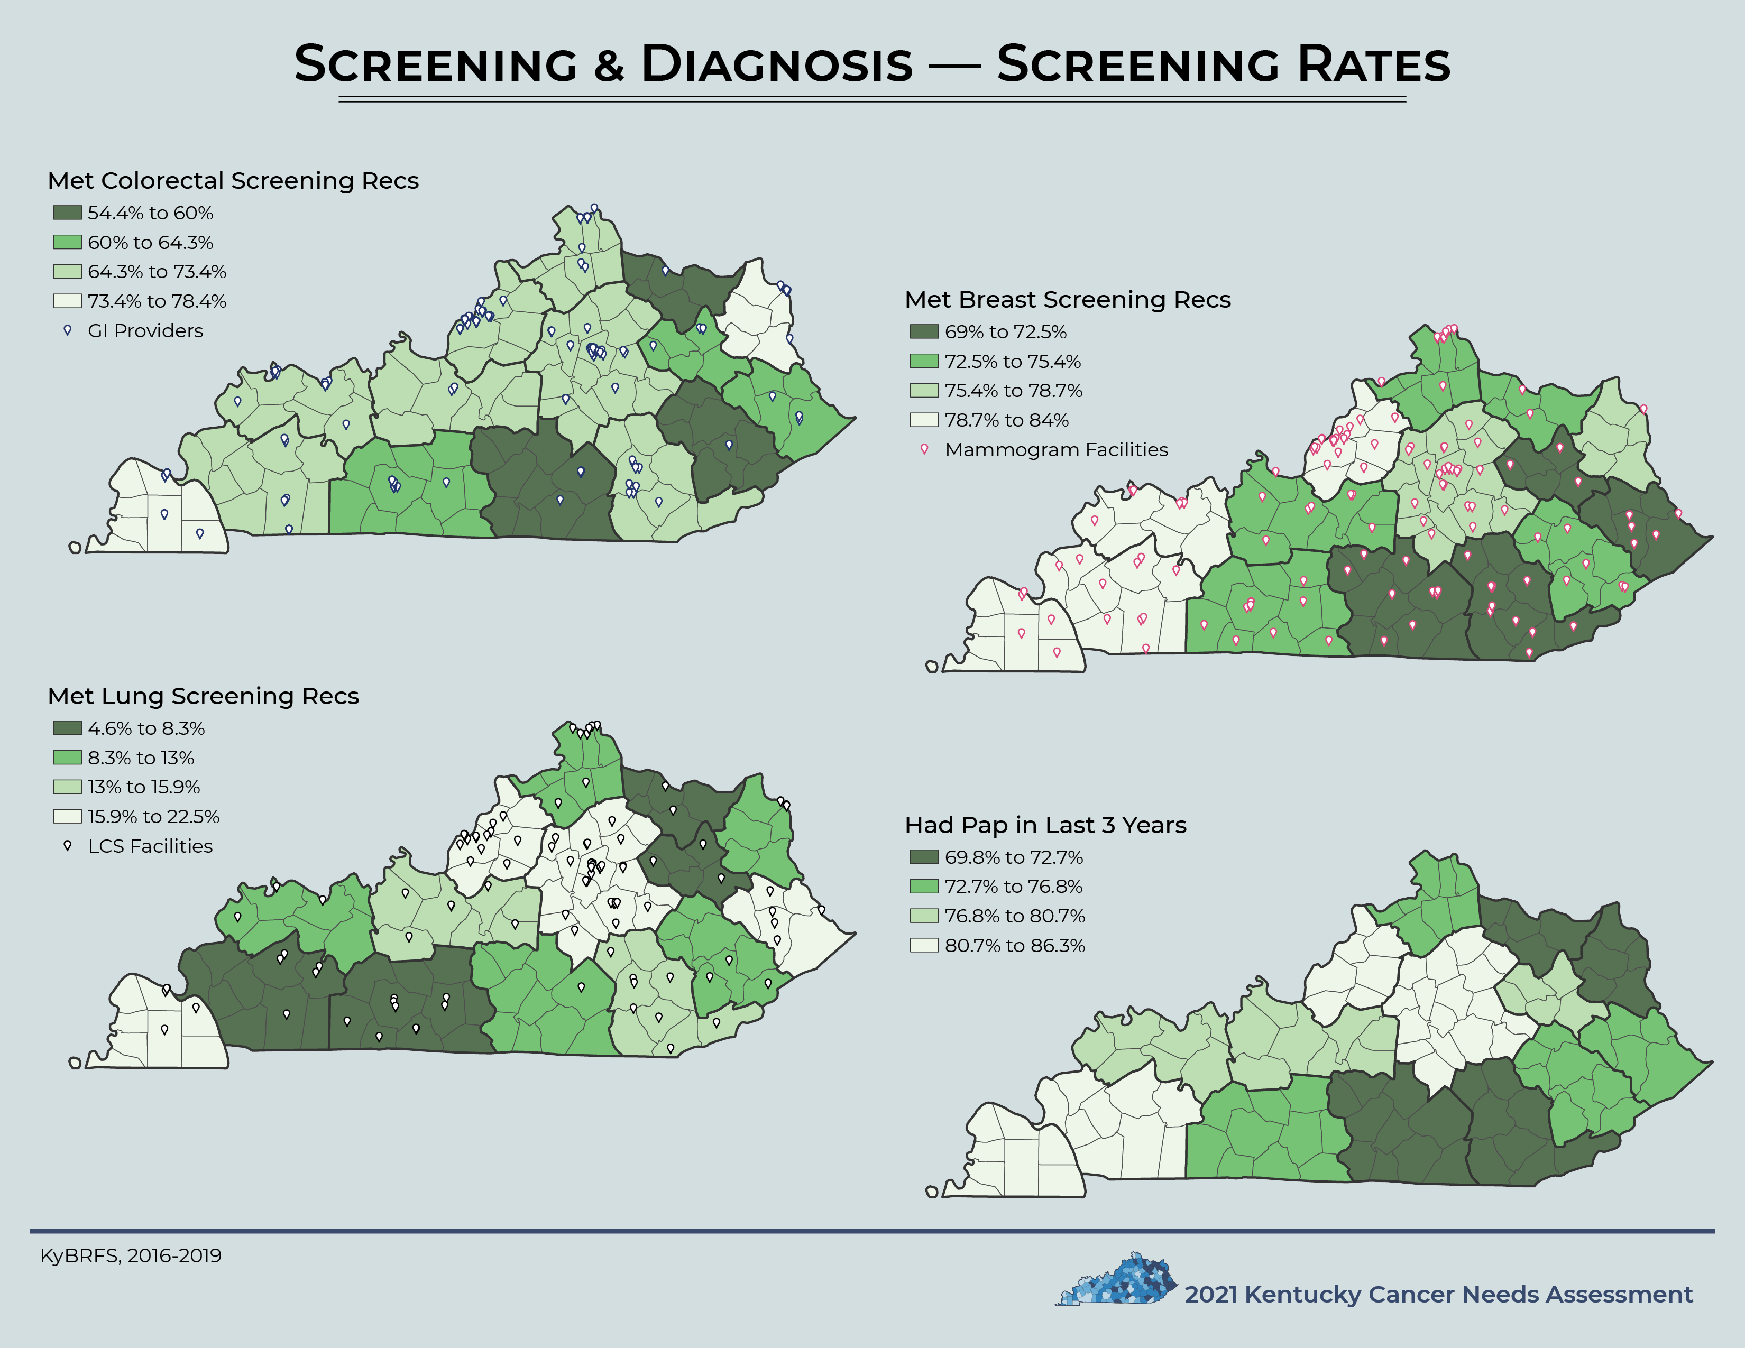

Slide 46
Section 4: Rewriting the Story

Slide 51
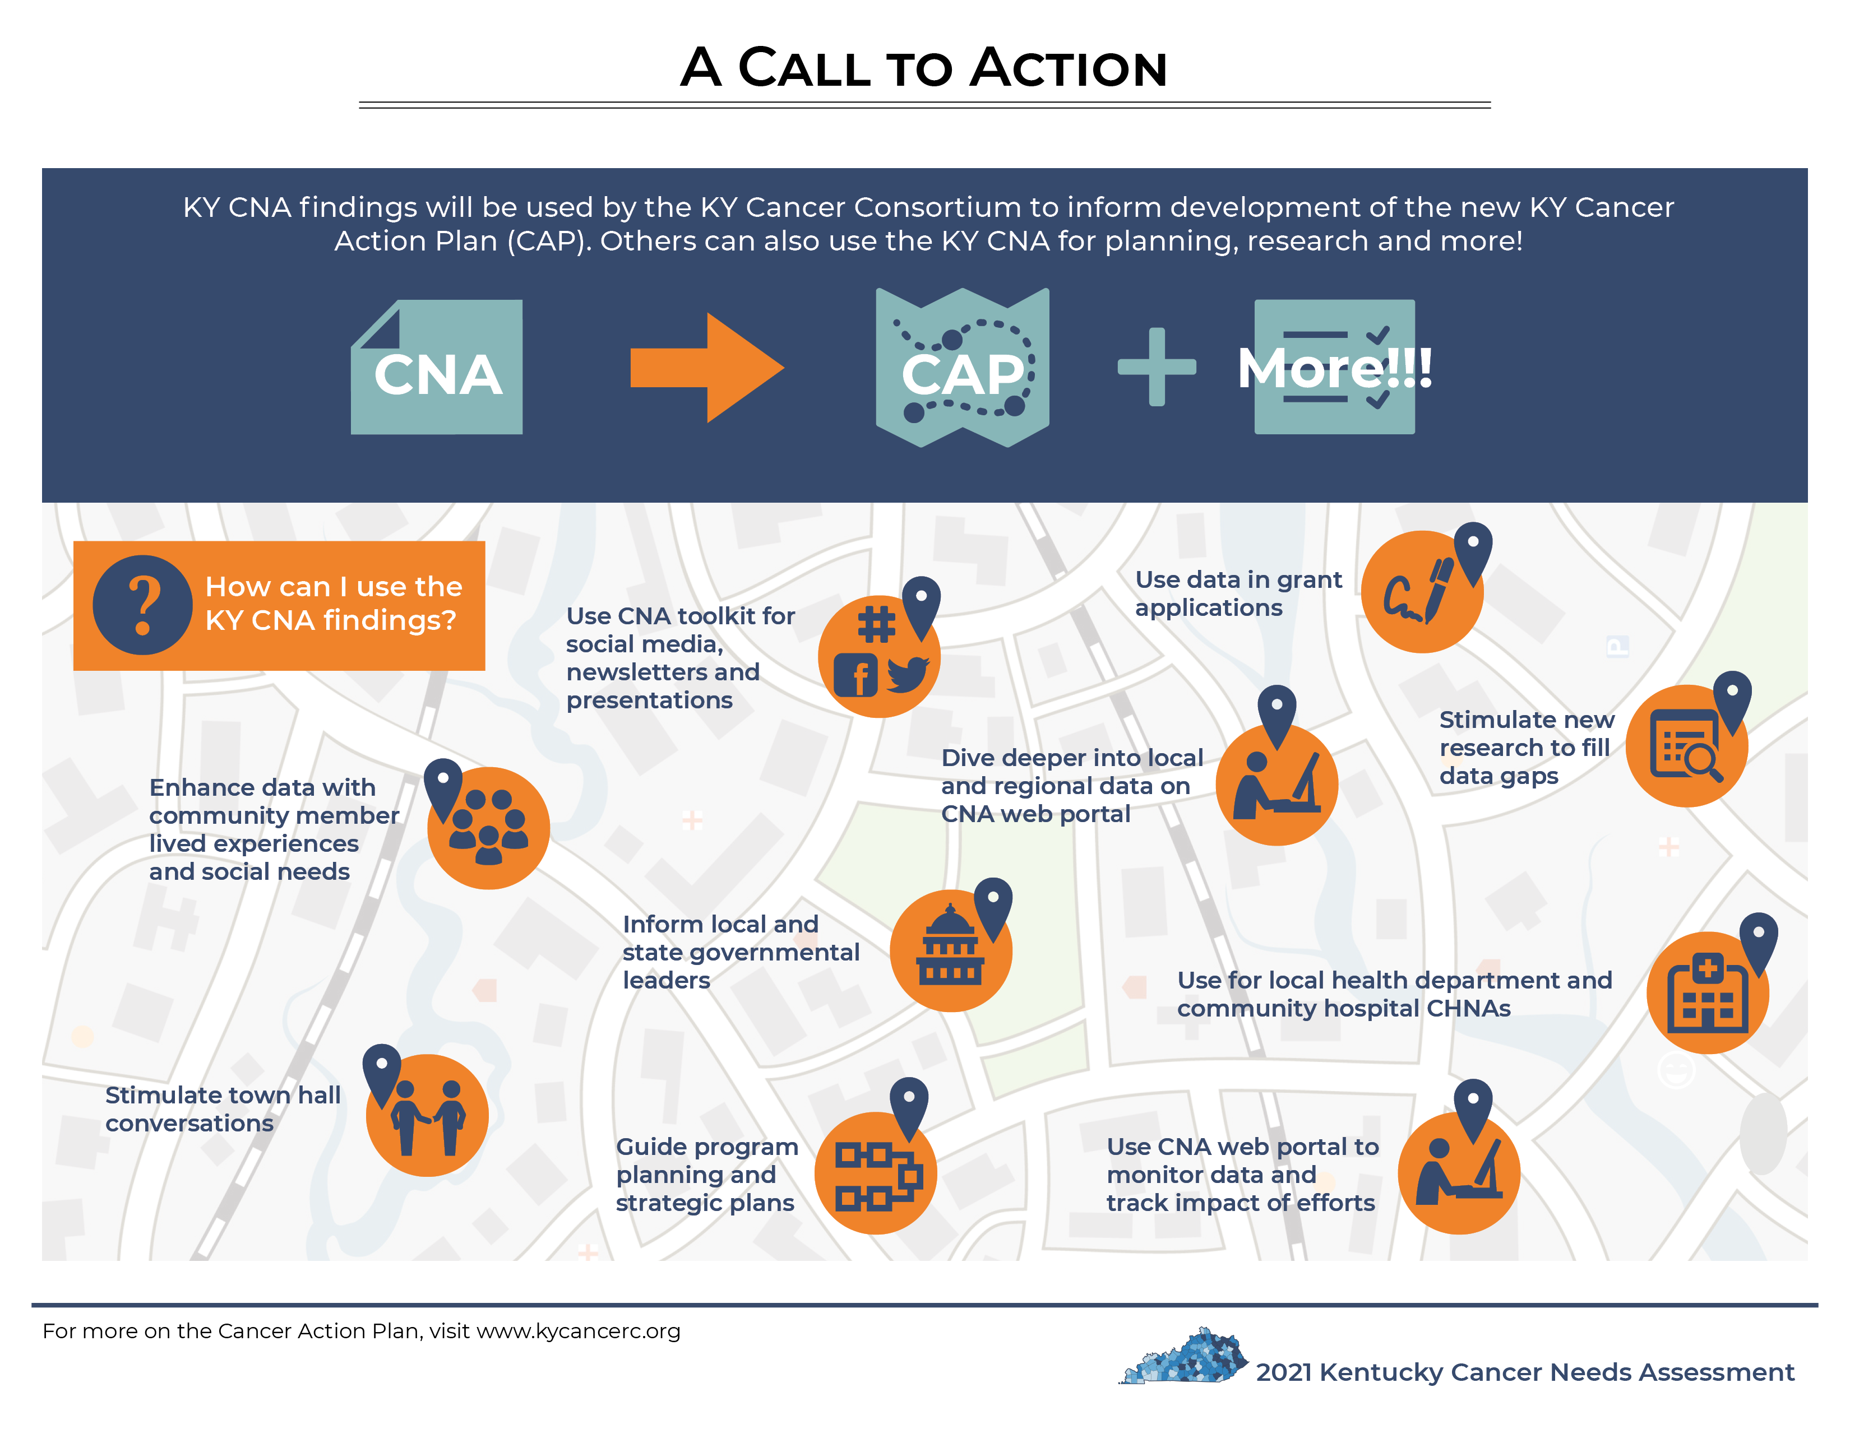

Slide 54
Section 5: Acknowledgements & Citations

